Slide 1
Ifstream, ofstream
Slides by Varick and Ashley Erickson
© Varick Erickson

Slide 2
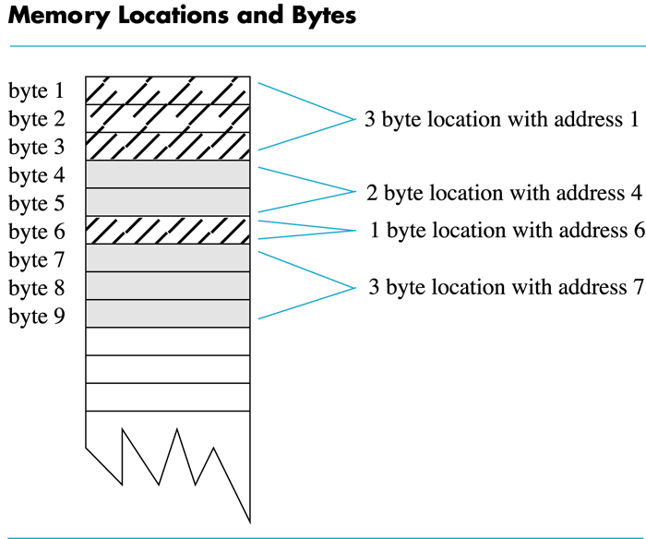
Recall from week 1: Variables and memory
Recall: a computer’s memory is divided into numbered locations called bytes.
Every variable must be stored at some location in memory
The location of a variable in the memory is called the memory address.
Note: if a variable takes up multiple bytes, the address is the location of the first byte.

Slide 3
Why memory addresses matter: we have seen some examples already!
Examples:
1. Arrays
The name of an array stores the memory address of its zeroth index
When arrays are used in functions, the memory address is passed into the function.
In arrays, only the memory address of the first item is remembered.
2. Call by reference
In call by reference, the memory address, not the variable name is passed into functions
That is why we use the ampersands (&) in call by reference: the ampersand allows us to pass the address of the variable into a function.

Slide 4
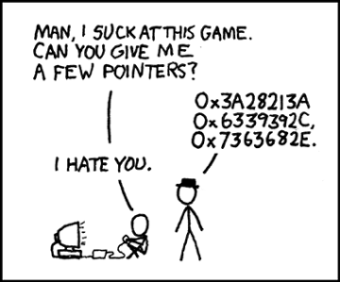
What is a pointer?
A pointer stores a memory address.
It is called a pointer because it “points” to a location in the memory.
Some value (int, double, etc) is stored at the memory address
https://xkcd.com/138/

Slide 5
Any questions far?
Next topic: how to declare pointers and important rules to follow.

Slide 6
The first few rules of pointers - overview
Use the reference operator & to get the memory address of a variable.
cout << &num; // prints memory address of num
Use the asterisk * when declaring pointer variables
int *ptr1, *ptr2, …;
//declares two pointer variables for int type
//spacing between * and ptr doesn’t matter
You cannot mix different data types with pointers.
Make sure you initialize pointers to a memory address, or the nullptr.
Use the correct wording to describe pointers.

Slide 7
Use & to get a variable’s memory address
Use address operator & to get address of a variable:
Just put an ampersand right in front of the variable’s regular name, with no space in between.
Example:
int num = -99;
cout << &num; // prints address in hexadecimal
int *ptr = &num; // declares pointer ptr // initialize to address of num

Slide 8
Use * when declaring pointers
Declare pointer type variables using an asterisk (*) :
TypeName *variableName1, *variableName2, …;
Note: you MUST have an asterisk in front of each pointer variable name.
Examples:
int *ptr1;
//declares a pointer variable ptr1
//read as “ptr1 holds a memory address for a type int”
double *pointer1, *pointer2;
//declares pointer1 and pointer2,
//each able to hold a memory address of type double

Slide 9
Declaring pointers and what happens in memory
Suppose we use the below code to declare a pointer and set its memody address:
int *ptr; //declare ptr
ptr = &num; //ptr points to address of num
In memory:
If we go to block 0x4a00, we will find 25 there
ptr
0x4a00
25
0x4a00

Slide 10
Note: spacing between * and pointer variable name doesn’t matter
Example:
int *ptr; (Read as: “ptr can hold the address of an int”)
Spacing does not matter:
int * ptr; // same as above
int* ptr; // same as above

Slide 11
Remember, you MUST include an asterisk next to each pointer variable
Variables which hold pointers must be declared as pointer type.
Remember, you MUST include an asterisk next to each pointer variable when declaring!
int *num1, *num2; //declares two pointer variables.
int *num1, *num2, v1, v2;
//declares two pointer variables
//and two regular old int variables v1 and v2.

Slide 12
Quick question
You want to declare pointer variables for two int type variables: num1 and num2.
Which is the correct way to declare the pointer variables?
A: int num1, num2;
B: int *num1, *num2;
C: int *num1, num2;
D: int* num1, num2;

Slide 13
Initializing Pointer Variables
You should always initialize your pointers. Often, you can give it the memory address of another variable right away using &.
If you don’t immediately have an address to give to your pointer, you should initialize it using nullptr
Example:
int *ptr = nullptr; //declare ptr and initialize to null
You can also test for an invalid address for ptr with:
if (!ptr) ...

Slide 14
You cannot mix data types with pointers!
Caution: pointer variables can only hold memory addresses of their own data type (int pointers hold int memory addresses, double pointers hold double memory addresses, etc)
You cannot mix data types:
double cost;
int *ptr = &cost; // won’t work // since cost is double

Slide 15
Use the correct wording to describe pointers
This helps you avoid sounding like a “noob” programmer.
Usually we speak of pointers rather than addresses when using pointer variables.
For example: num1 = &v1;
We don’t usually say “num1 = ampersand v1”
We say: “num1 points to v1”
OR “the pointer num1 points to the variable v1”

Slide 16
Quick question
What will this code output? Assume myIntVariable is being stored at address 0380FED4.
A: 99 0380FED4
B: 0380FED4 99
C: The code will not compile
D: 99 99
#include <iostream>
using namespace std;
int main()
{
int myIntVariable = 99;
int *myIntVariablesPointer;
myIntVariablesPointer = &myIntVariable;
cout << myIntVariable << " " << myIntVariablesPointer << endl;
return 0;
}

Slide 17
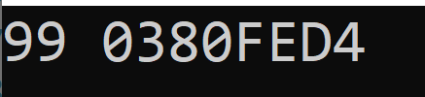
Outputting pointer variables
Outputs the variable myIntVariable (99)
Outputs the pointer variable’s value (the memory address where myIntVariable is stored)
#include <iostream>
using namespace std;
int main()
{
int myIntVariable = 99;
int *myIntVariablesPointer;
myIntVariablesPointer = &myIntVariable;
cout << myIntVariable << " " << myIntVariablesPointer << endl;
return 0;
}

Slide 18
Any questions before we continue?
Next topic: more rules about pointers

Slide 19
The next few rules of pointers - overview
6. Using * and a pointer variable name will return the value of what we are pointing at.
cout << *ptr1 << endl; //returns value ptr1 is pointing at
7. Using the assignment operator (=) changes the pointer’s memory address, which changes where our pointer points. This will change the pointer’s memory address, but will not change the value of the data stored in that memory!
8. Using = and * directly changes the value that our pointer is pointing to.
9. Use the new operator to create a new variable at a specified location in memory.

Slide 20
Use * to return the value of what we are pointing at
We use the asterisk to declare pointer variables
The asterisk can also be used to return the value of what we are pointing at.
#include <iostream> using namespace std; int main() { int myIntVariable = 99; // declare myIntVariable and set it to 99 int *myIntVariablesPointer; // declare pointer variable myIntVariablesPointer = &myIntVariable; // Set pointer to address of myIntVariable cout << myIntVariable << endl; // prints value of myIntVariable cout << myIntVariablesPointer << endl; // Prints the memory address of myVariable cout << *myIntVariablesPointer << endl; // Prints value which pointer is pointing at (myVariable) return 0; }

Slide 21
* As the “dereferencing operator”
When we use the * operator to output the value at a pointer, it is called the dereferencing operator
* allows you to access the data the pointer was pointing to
The variable which * is used on is called “dereferenced”.
Example:
cout << *myPointer << endl;
// returns value which myPointer is pointing at
// * is being used as a dereferencing operator
// myPointer is being “dereferenced”

Slide 22
An alternate way of outputting variables
Pointers allow us an alternative method of outputting the value of variables
“Usual way”: use cout and the variable’s name.
cout << myIntVariable << endl;
// prints value of myIntVariable
“New” way : use cout and the pointer variable’s name, with an asterisk in front of the variable’s name.
cout << *myIntVariablesPointer << endl;
// prints value which pointer is pointing at (myIntVariable)

Slide 23
Question
Suppose I have the code shown.
Which is the correct way to output the value of myVariable (9999) using myPointer?
A: cout << myPointer;
B: cout << *myPointer;
C: cout << &myPointer;
D:cout << myPointer*;
#include <iostream>
using namespace std;
int main()
{
int myVariable = 9999;
int* myPointer;
myPointer = &myVariable;
// output myVariable using myPointer
return 0;
}

Slide 24
Codey sense question
#include <iostream>
using namespace std;
int main()
{
// declare variable1 = 4 and variable2 = 2
// declare pointers for each
int variable1 = 4;
int* var1pointer = &variable1;
int variable2 = 2;
int* var2pointer = &variable2;
var2pointer = var1pointer;
//what will this output?
cout << *var2pointer;
return 0;
}
What will this code output?
It won’t compile
2
4
It will output the memory address of var2pointer

Slide 25
Using = with pointers
#include <iostream>
using namespace std;
int main()
{
//declare variable1 = 4 and variable2 = 2
//declare pointers for each
int variable1 = 4;
int* var1pointer = &variable1;
int variable2 = 2;
int* var2pointer = &variable2;
var2pointer = var1pointer;
//now var2 pointer will point to var1
cout << *var2pointer;
return 0;
}
You CAN use the assignment operator (= ) with pointer variables.
Be careful when using =. It will cause your pointer variables to point to whatever new thing the new pointer is pointing at.
= changes the memory address but not the value the pointer is pointing at

Slide 26
Follow-up codey sense question
#include <iostream>
using namespace std;
int main()
{
//declare variable1 = 4 and variable2 = 2
//declare pointers for each
int variable1 = 4;
int* var1pointer = &variable1;
int variable2 = 2;
int* var2pointer = &variable2;
*var2pointer = *var1pointer;
//what will this output?
cout << variable1 << " " << variable2;
return 0;
}
What will this code output?
It won’t compile
2 2
4 2
4 4

Slide 27
Caution!!! Using = and * with pointers
#include <iostream>
using namespace std;
int main()
{
//declare variable1 = 4 and variable2 = 2
//declare pointers for each
int variable1 = 4;
int* var1pointer = &variable1;
int variable2 = 2;
int* var2pointer = &variable2;
*var2pointer = *var1pointer;
//Caution!!! This is same as writing
//variable2 = variable1
cout << variable1 << " " << variable2;
return 0;
}
You CAN use the assignment operator (= ) and asterisk (*)with pointer variables.
Be careful when using = and * together!
This will cause one pointer’s variable to be set equal to another pointer’s variable.
Use with caution!

Slide 28
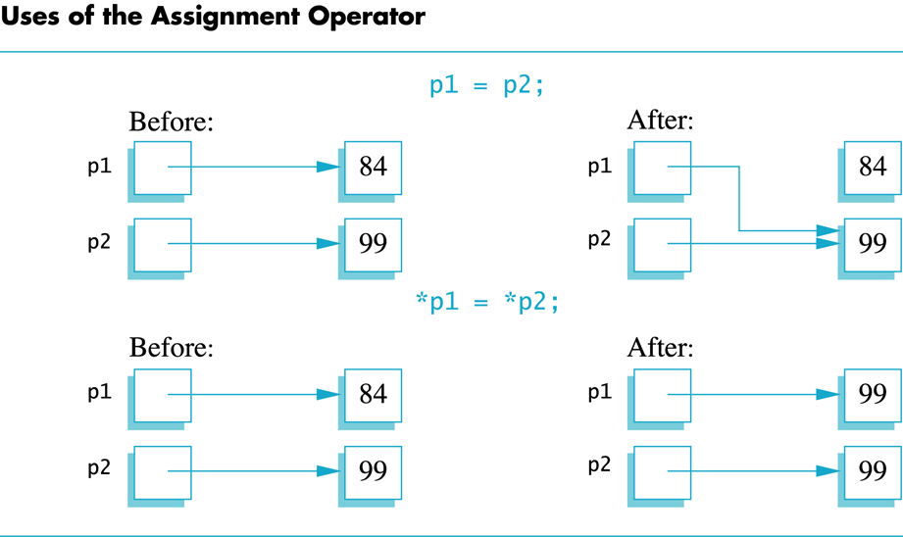
What is happening in memory when we use = and * ?
Using = changes the pointer’s memory address, which changes where our pointer points.
Using = and * directly changes the value that our pointer is pointing to.

Slide 29
The new operator
The new operator can be used to make a new address to store a value
It will return an address of a block of memory big enough to hold a variable.
Example:
// declare pointer p1 and initialize to new int
int* p1;
p1 = new int; // pointer p1 now stores an address
// big enough to hold an int

Slide 30
The new operator
#include <iostream>
using namespace std;
int main()
{
//declare pointer p1 and initialize to new int
int* p1;
p1 = new int;
//check initial memory
cout << "Currently, the memory at p1 reads: " << *p1 << endl;
//prompt user for new value
cout << "\nEnter a variable to assign to the new int: \n";
cin >> *p1; //copy input to p1's location
cout << "\nNow our pointer p1 holds the value: " << *p1
<< "\nHave a nice day!";
return 0;
}

Slide 31
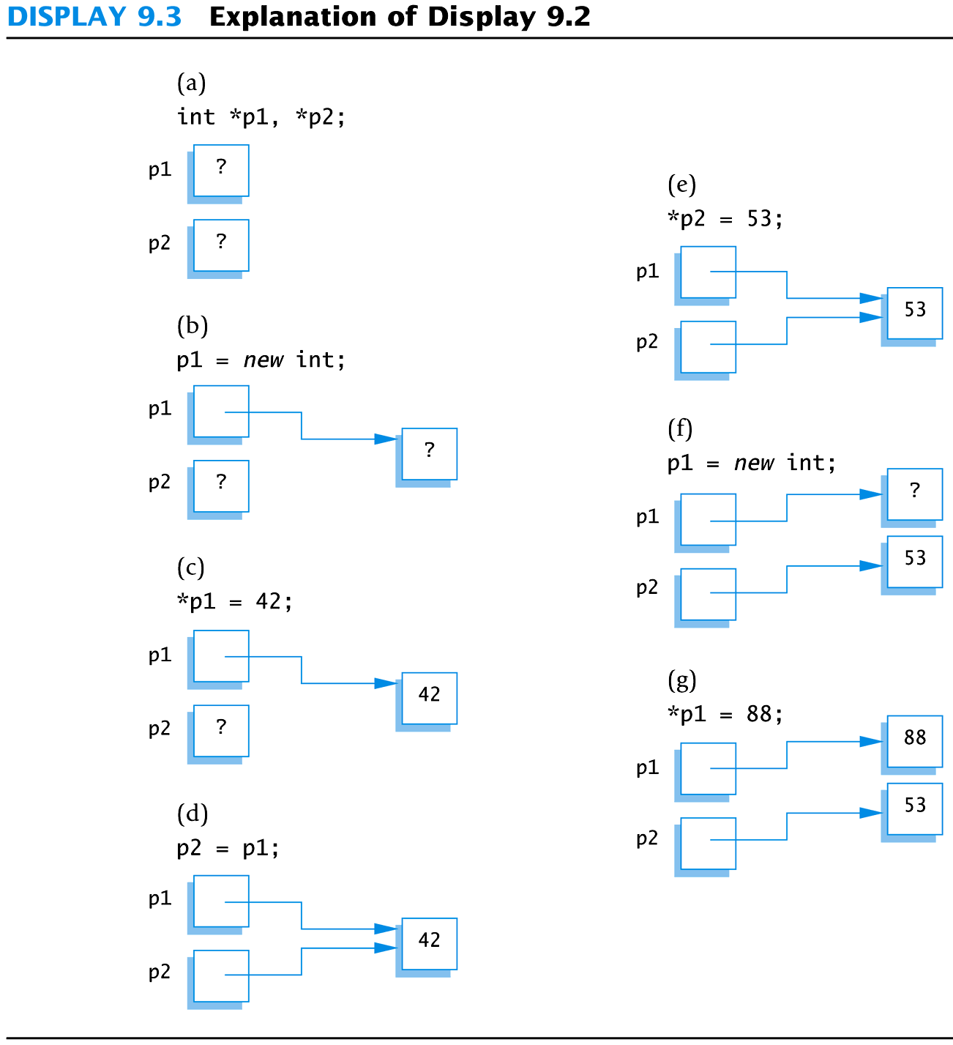
Example
#include <iostream>
using namespace std;
int main()
{
int* p1, *p2;
p1 = new int;
*p1 = 42;
cout << "We declared pointers p1 and p2, and set *p1 to 42"
<< "\nsetting pointer p2 = p1 gives:\n";
p2 = p1;
cout << "\n*p1 = " << *p1 << endl;
cout << "*p2 = " << *p2 << endl;
*p2 = 53;
cout << "Now setting *p2 to 53..." << endl;
cout << "*p1 = " << *p1 << endl;
cout << "*p2 = " << *p2 << endl;
p1 = new int;
*p1 = 88;
cout << "Now setting p1 to new int and value 88" << endl;
cout << "*p1 = " << *p1 << endl;
cout << "*p2 = " << *p2 << endl;
cout << "Hope you got the point of this example!";
return 0;
}

Slide 32
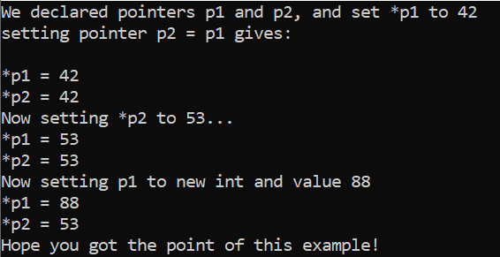
Output
#include <iostream>
using namespace std;
int main()
{
int* p1, *p2;
p1 = new int;
*p1 = 42;
cout << "We declared pointers p1 and p2, and set *p1 to 42"
<< "\nsetting pointer p2 = p1 gives:\n";
p2 = p1;
cout << "\n*p1 = " << *p1 << endl;
cout << "*p2 = " << *p2 << endl;
*p2 = 53;
cout << "Now setting *p2 to 53..." << endl;
cout << "*p1 = " << *p1 << endl;
cout << "*p2 = " << *p2 << endl;
p1 = new int;
*p1 = 88;
cout << "Now setting p1 to new int and value 88" << endl;
cout << "*p1 = " << *p1 << endl;
cout << "*p2 = " << *p2 << endl;
cout << "Hope you got the point of this example!";
return 0;
}

Slide 33
Any questions before we continue?
Next topic: dynamic variables and things to remember

Slide 34
Things to remember about dynamic variables
Dynamic variables are created using pointers and the new operator.
Dynamic variables are called dynamic because they are created and destroyed while the program is running.
Up to this point in the class, we have been using “ordinary” variables. Variables we declare in main or other functions are also called “ordinary” or “automatic” variables. These are automatically created when the program starts and automatically deleted when the program ends.
Dynamic variables are stored in the heap memory. Ordinary variables are stored in the stack memory.
Dynamic variables must be deleted manually. Use the delete operator to eliminate a dynamic variable when you are done using it. This is useful to free up memory. Be careful to avoid producing dangling pointers.

Slide 35
Using the delete operator
The delete operator eliminates a dynamic variable and allows the heap memory to be reused.
Example: to delete the pointer variable pointed to by p:
delete p;
After delete, the value of p is undefined and p should be treated as if it is uninitialized.
NOTE: delete does NOT make set the pointer to nullptr
Make sure you do not accidentally delete something else when you delete your pointer. Deleting a pointer may produce dangling pointers (pointer variables which do not point to anything). This can create major problems!

Slide 36
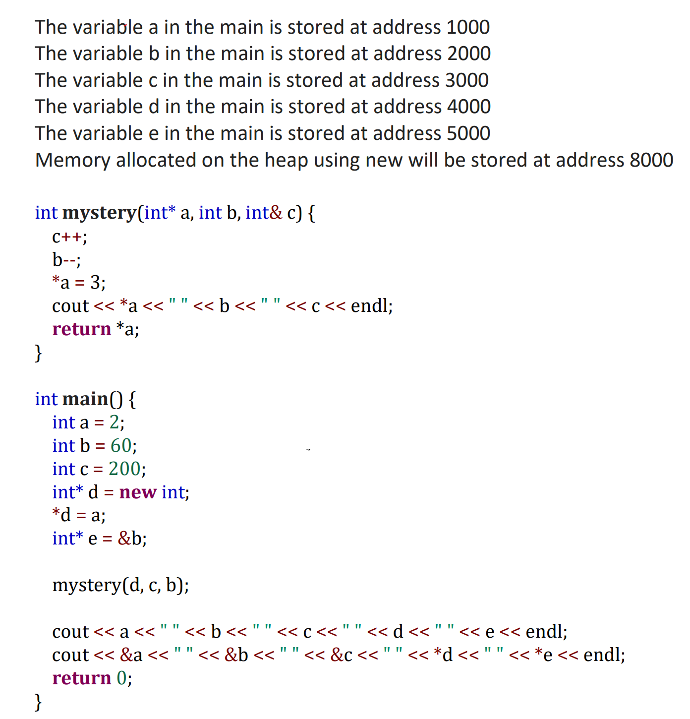
Pointer Practice Question: Write the output
Notes:
Consider printing this out for students

Slide 37
Any questions before we continue?

Slide 38
Codey sense question
What will be the output from this code?
#include <iostream>
using namespace std;
int main()
{
int numbers[] = { 10, 20, 30, 40, 50 };
cout << *numbers << endl;
return 0;
}
A: The memory address of numbers
B: It will not compile
C: 10, 20, 30, 40, 50
D: 10
E: None of these

Slide 39
Recall: Arrays use memory addresses!
Recall: when storing data in arrays, we remember the memory address of the array’s first item
In C++, an array’s name is actually a pointer (pointing to the address of element 0), we can treat array names like pointers.
CAUTION: You CANNOT change the pointer value in an array variable. This would assign a different memory address to the array, which is illegal.

Slide 40
The Relationship Between Arrays and Pointers
The array name is the memory address of the first element in an array
int vals[] = {4, 7, 11};
cout << vals; // displays 0x4a00
cout << vals[0]; // displays 4
4 | 7 | 11
starting address of vals: 0x4a00

Slide 41
Arrays and Pointers: Things to remember
In C++, an array variable is actually a pointer variable which points to the first indexed variable of the array.
No bounds checking is performed on array access, whether using array name or a pointer
Pointers can be used in functions. You need * in the prototype/declaration and definition. Use the pointer’s address as argument to the function when calling.
Functions can return pointers. A function should only return a pointer to data passed into the function or to dynamically allocated memory. The function must not return a pointer to a local variable in the function.

Slide 42
More on the Relationship Between Arrays and Pointers
Array name can be used as a pointer constant:
int vals[] = {4, 7, 11};
cout << *vals; // displays 4
Pointer can be used as an array name:
int vals[] = {4, 7, 11};
int *valptr = vals;
cout << valptr[1]; // displays 7

Slide 43
Any questions before we continue?
Next topics:
Accessing array elements with pointers
Pointer arithmetic
Using pointers in functions

Slide 44
Ways to access array elements using pointers
Array elements can be accessed in many ways:
Array access method | Example
array name and [] | vals[2] = 17;
pointer to array and [] | valptr[2] = 17;
array name and subscript arithmetic | *(vals + 2) = 17;
pointer to array and subscript arithmetic | *(valptr + 2) = 17;

Slide 45
Pointer Arithmetic
Operations on pointer variables:
Operation | Example int vals[]={4,7,11}; int *valptr = vals;
++, -- | valptr++; // points at 7 valptr--; // now points at 4
+, - (pointer and int) | cout << *(valptr + 2); // 11
+=, -= (pointer and int) | valptr = vals; // points at 4 valptr += 2; // points at 11
- (pointer from pointer) | cout << valptr–val; // difference //(number of ints) between valptr // and val

Slide 46
Comparing Pointers
Relational operators (<, >=, etc.) can be used to compare addresses in pointers
Comparing addresses in pointers is not the same as comparing contents pointed at by pointers:
if (ptr1 == ptr2) // compares addresses
if (*ptr1 == *ptr2) // compares contents

Slide 47
Pointers as Function Parameters
A pointer can be a parameter
Works like reference variable to allow change to argument from within function
Requires:
asterisk * on parameter in the function’s prototype/declaration and definition
void getNum(int *ptr); // ptr is pointer to an int
Use asterisk * in body to dereference the pointer and return the value at that location
cin >> *ptr;
Use the pointer’s address as argument to the function when calling
getNum(&num); // pass address of num to getNum
Notes:
Show sample code

Slide 48
Example: pointers in functions
//This program uses two functions that accept
//addresses of variables as arguments
#include <iostream>
using namespace std;
//function declarations
void getNumber(int*);
//Precondition: input parameter is a valid memory address
//Postcondition: prompts user for an int number to store at the address
void doubleValue(int*);
//Precondition: input parameter is a valid memory address and contains an int value
//Postcondition: doubles the int value located at the input memory address
int main()
{
int number;
// Call getNumber and pass the address of number...
getNumber(&number);
// Call doubleValue and pass the address of number...
doubleValue(&number);
// display the value in number:
cout << "Your number doubled is: " << number << endl;
return 0;
}
void getNumber(int* input)
{
cout << "Enter an integer number: ";
cin >> *input;
cout << "You entered: " << *input << ".\n";
}
void doubleValue(int *val)
{
*val = *val * 2;
}
Note how the pointer is used in functions:
asterisk in the prototype/declaration and definition
asterisk * in body to dereference the pointer
address is used as argument to the function

Slide 49
Returning Pointers from Functions
Pointer can be the return type of a function:
int* newNum();
The function must not return a pointer to a local variable in the function. Remember, local variables in a function will be destroyed when the function ends.
A function should only return a pointer:
to data that was passed to the function as an argument, or
to dynamically allocated memory

Slide 50
Review question
Which of the following statements about pointers and functions is FALSE?
When using pointers in functions, You need to put * on the pointers in the declaration and definition
The pointer’s address is used as the argument when calling a function
Functions can return pointers
If you return a pointer which points to a function’s local variable, the local variable will not be destroyed when the function execution ends.

Slide 51
Quick recap
So far, we have learned…
We can use pointers to manipulate memory at a given location that array variables are actually pointer variables.
We can use pointers to manipulate arrays.
We can use the “new” operator and dynamic variables to create variables while the program is running.

Slide 52
Motivation for dynamic arrays
Arrays have a problem. We must specify the size when we write our programs. This creates two main issues:
Issue #1: We estimate the largest possible size to be safe. We could estimate too low and cause problems.
Issue #2: If a lot of our array is unused, we waste memory.
We can avoid these issues by using dynamic arrays.

Slide 53
Even More Motivation for dynamic arrays
Dynamic arrays are created using the new operator. This allows us to create an array with exactly the right size while our program is running.
Dynamic arrays otherwise behave the same as regular arrays.
Under the hood, vectors use dynamic arrays. All the stuff is hidden away in the vector functions and included when we do #include <vector>.
Some students may have had trouble with stack overflow errors. If you use a dynamic array, you will avoid this error.
Heap memory is limited by the compiler and your computer’s RAM, but it can give you more wiggle room when writing your programs.

Slide 54
How to use dynamic arrays in 4 easy steps…
Declare a pointer variable
double* d;
Use new to create a dynamic array with the new operator with the desired size
d = new double[array_size];
Use your dynamic array just like a regular array
When you are finished with your dynamic array, delete it.
delete [] d;

Slide 55
Example code: creating dynamic array
#include <iostream>
using namespace std;
int main() {
const int array_size = 10;
//declare pointer d
double* d;
//create a new double array at the pointer d's memory address
d = new double[array_size];
cout << "We have just created our dynamic array, containing " << array_size << " items:\n";
for (int i = 0; i < array_size; i++ ) {
d[i] = i;
cout << d[i] << endl;
}
//delete d when finished
delete[] d;
return 0;
}
This example shows how to make a dynamic array containing 10 double variables. To make a different type of dynamic array, just change array_size and double.

Slide 56
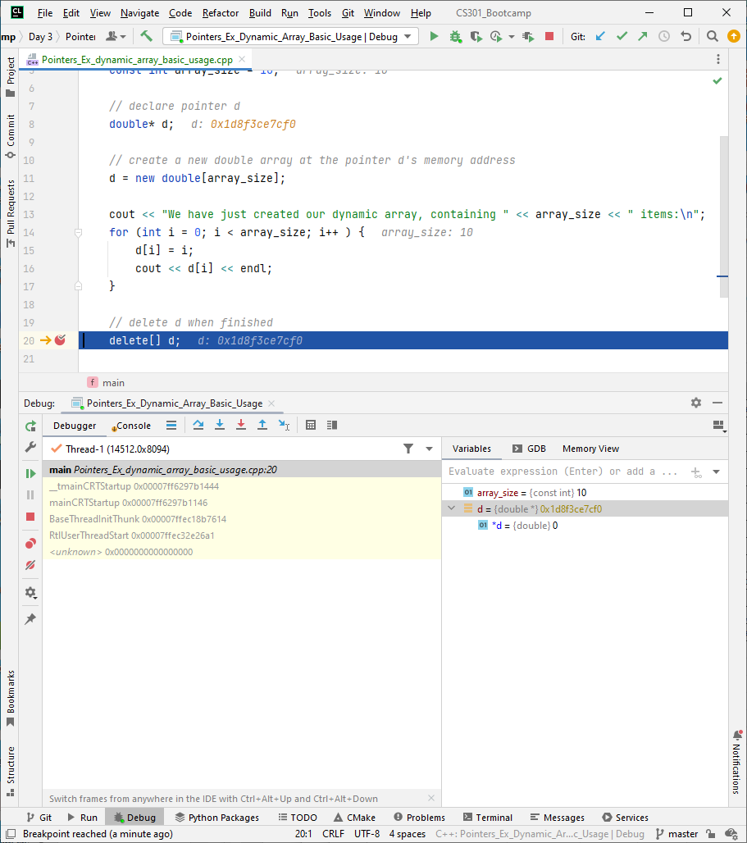
Debugging Note
The debugger cannot determine if a pointer points to a single value or to an array of values.
By default, the debugger assumes a pointer points to a single value
You need to tell the debugger if the variable represents an array.

Slide 57
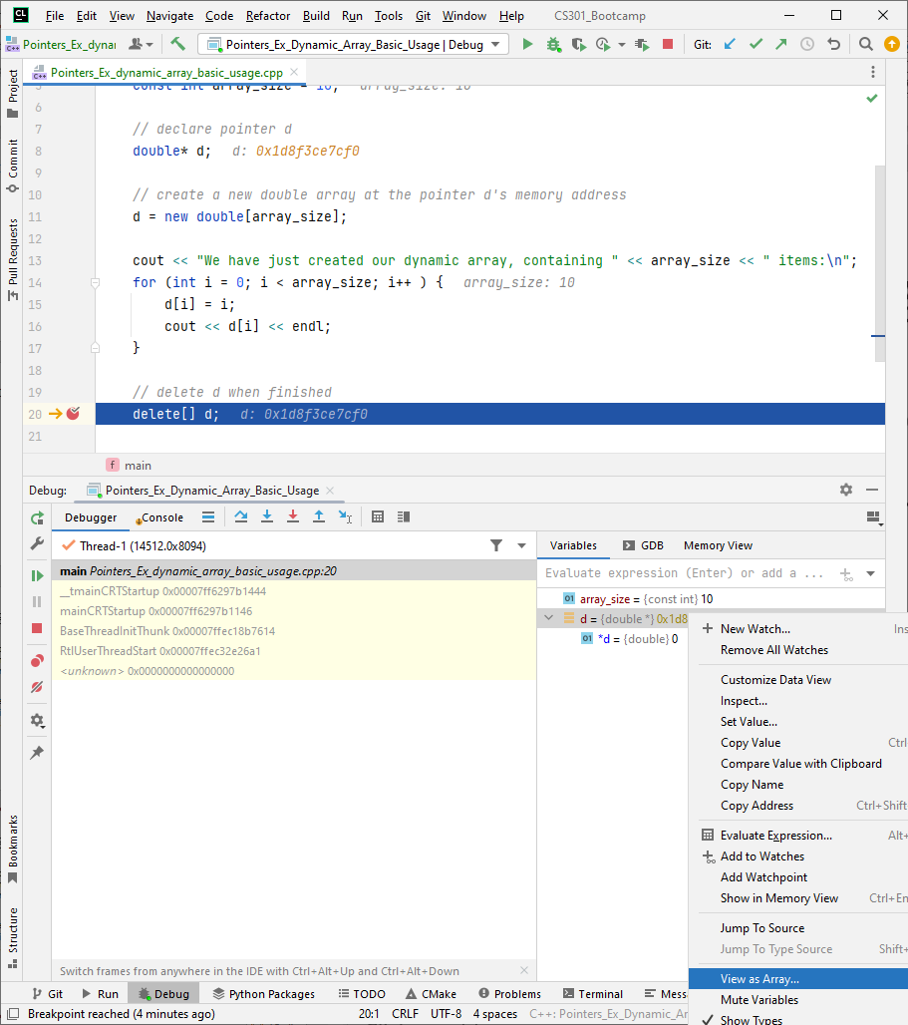
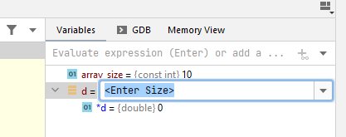
Debugging Note
Right click the variable, then select “View as Array…”
It will then prompt you for the size of the array

Slide 58
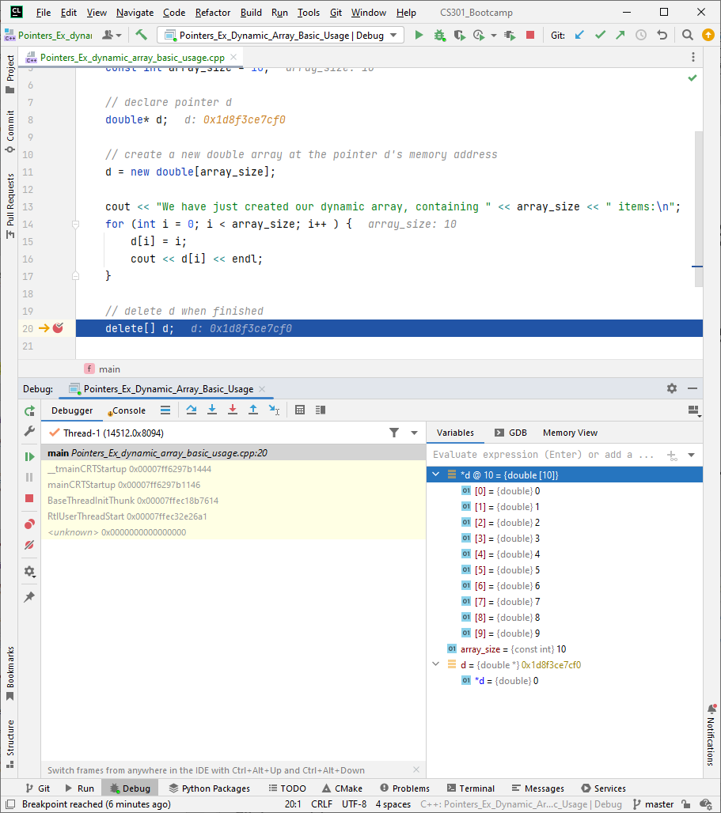
Debugging Note
Now you can view the contents of the pointer variable as an array.

Slide 59
Quick review question
Which of the following statements about dynamic arrays is FALSE?
A: You need to use the new operator when declaring a dynamic array
B: Your pointer does not need to point to the same data type as your dynamic array’s data type.
C: You can use your dynamic array just like a regular array
D: When you are finished with your dynamic array, you can delete it using the delete operator.

Slide 60
Any questions before we continue?
Next topic: pointers and multidimensional dynamic arrays

Slide 61
Multidimensional dynamic arrays
You can make multidimensional dynamic arrays
Remember that multidimensional arrays are just arrays of arrays.
Example: to create a 2D dynamic array of integers:
1. Create a 1-D dynamic array of pointers of type int*
2. Create a dynamic array of int for each indexed variable of the pointer array.
A type definition can help keep things straight

Slide 62
Example: Two-dimensional dynamic array
#include <iostream>
using namespace std;
//declare int pointer type to make our lives easier
typedef int* IntArrayPtr;
int main()
{
int d1, d2;
cout << "Enter the row and column dimensions of the array: \n";
cin >> d1 >> d2;
IntArrayPtr* m = new IntArrayPtr[d1];
int i, j;
for (i = 0; i < d1; i++)
m[i] = new int[d2];
// m is now a d1 by d2 array
cout << "Enter " << d1 << " rows of "
<< d2 << " integers each: \n";
for (i = 0; i < d1; i++)
for (j = 0; j < d2; j++)
cin >> m[i][j];
cout << "Outputting the two-dimensional array: \n";
for (i = 0; i < d1; i++)
{
for (j = 0; j < d2; j++)
cout << m[i][j] << " ";
cout << endl;
}
//delete when finished
//there must be one call to delete[]
//for each call to new that created an array.
//these delete calls aren't really needed since this program
//is ending, but included for reference
for (i = 0; i < d1; i++)
delete[] m[i];
delete[] m;
return 0;
}

